Slide 1
File Handling in Python

Slide 2
File Handling
Python supports file handling and allows users to handle files i.e., to read and write files, along with many other file handling options, to operate on files
Python treats files differently as text or binary and this is important.
Each line of a file is terminated with a special character, characters like comma {,} or newline character.
The key function for working with files in Python is the open() function.
Mode to create:
"x" - Creates the specified file, returns an error if the file exists

Slide 3
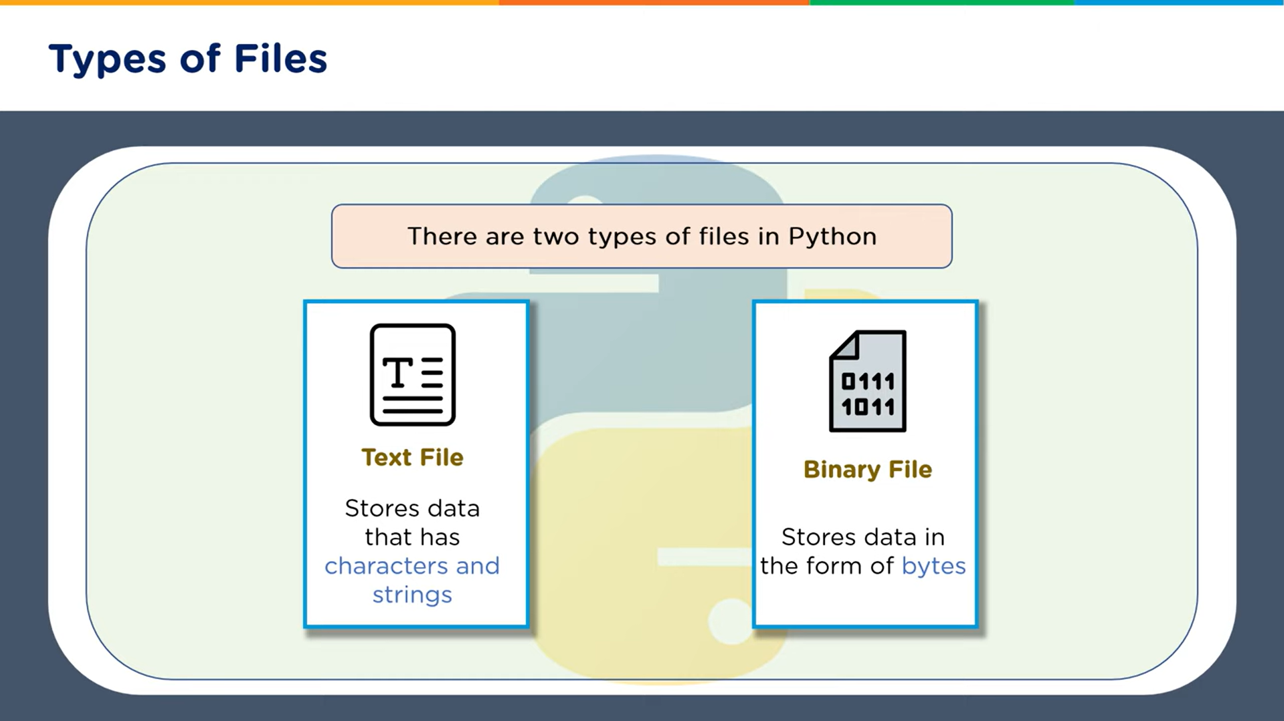

Slide 4
Types of Files
There are two types of Files: Text file and Binary File
What is a text file?
- A text file consists of human readable characters, which can be opened by any text editor.
What is a binary file?
- Binary files are made up of non-human readable characters and symbols, which require specific programs to access its contents.
Modes used are text and binary files:
-"t" - Text - Default value. Text mode
-"b" - Binary - Binary mode (e.g. images)

Slide 5
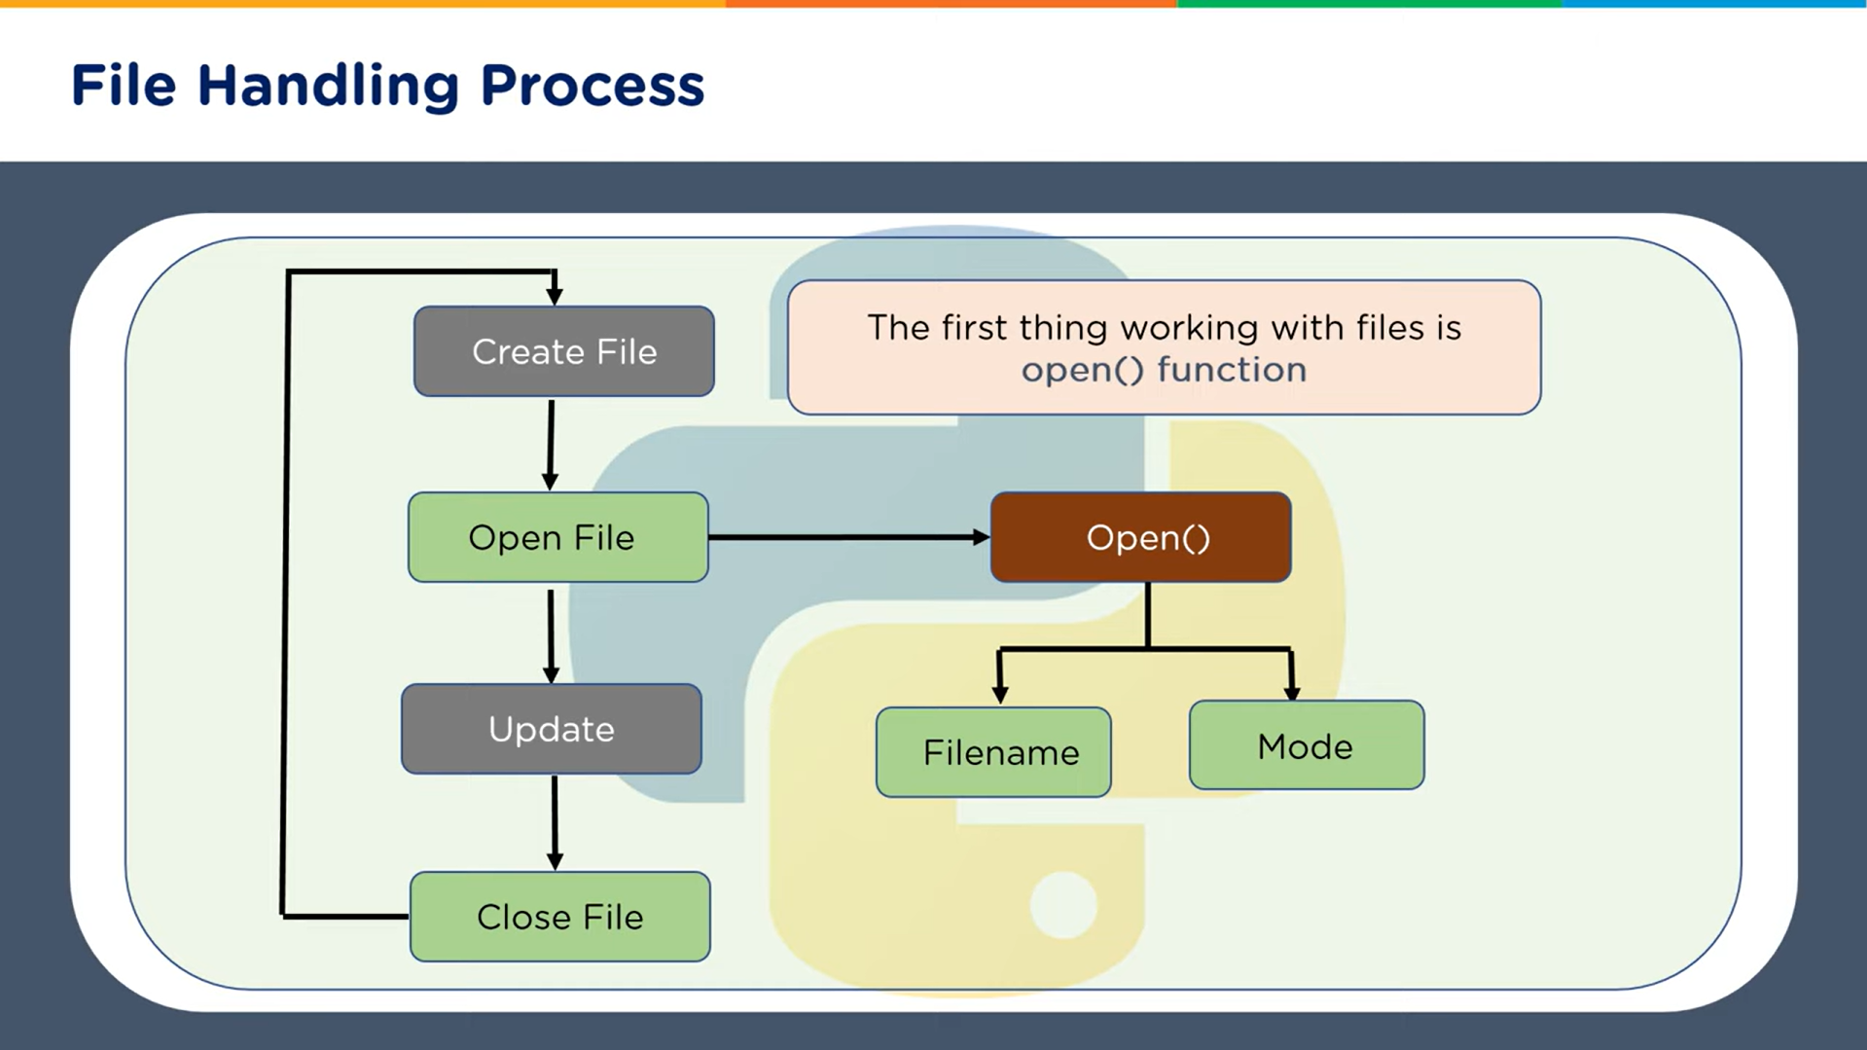

Slide 6
Modes in file handling
There are different methods (modes) for opening a file:
Read:
"r" - Default value. Opens a file for reading, error if the file does not exist
Append:
"a" - Opens a file for appending, creates the file if it does not exist
Write:
"w" - Write - Opens a file for writing, creates the file if it does not exist
Read:
“r+” - This mode does not override the existing data, but you can modify the data starting from the beginning of the file.
Append:
“a+”: To append and read data from the file. It won’t override existing data.
Write:
“w+”- It overwrites the previous file if one exists, it will truncate the file to zero length or create a file if it does not exist.

Slide 7
1. Create File
Syntax:
open("newfile.txt", "x").close()
open() method is used function is used to open a file and return a file object.
This code creates a file named “newfile.txt” if it doesn't already exist.
"x” - Create - Creates the specified file, returns an error if the file exists.
The “close()” method is called immediately after to close the file.
Syntax if a binary file:
open("newfile.bin", "xb").close()

Slide 8
Write In file
Syntax:
with open(“newfile.txt", "w") as f:
f.write("Hello World!!!")
"w" - Write - Opens a file for writing
Creates the file if it does not exist
Syntax if a binary file
with open(“newfile.bin", "wb") as f:
f.write("Hello World!!!")

Slide 9
Append to file
Syntax:
with open(“newfile.txt", "a") as file:
file.write("Your text to append\n")
"a" - Append - Opens a file for appending
Creates the file if it does not exist
Syntax if binary file
with open(“newfile.bin", "ab") as file:
file.write("Your text to append\n")

Slide 10
Read file
Syntax:
with open("filename.txt", "r") as file:
content = file.read()
print(content)
“r" - Read - Default value. Opens a file for reading, error if the file does not exist. If you need to read the file line by line:
with open("filename.txt", "r") as file:
for line in file:
print(line, end=‘’)
Syntax if binary file:
with open("filename.bin, "rb") as file:
content = file.read()
print(content)

Slide 11
Delete file
Syntax:
import os
os.remove(“newfiles.txt")
import os module which provides a way to interact with the operating system.
Then removes the file
Syntax if binary file
import os
os.remove(“newfiles.bin")

Slide 12
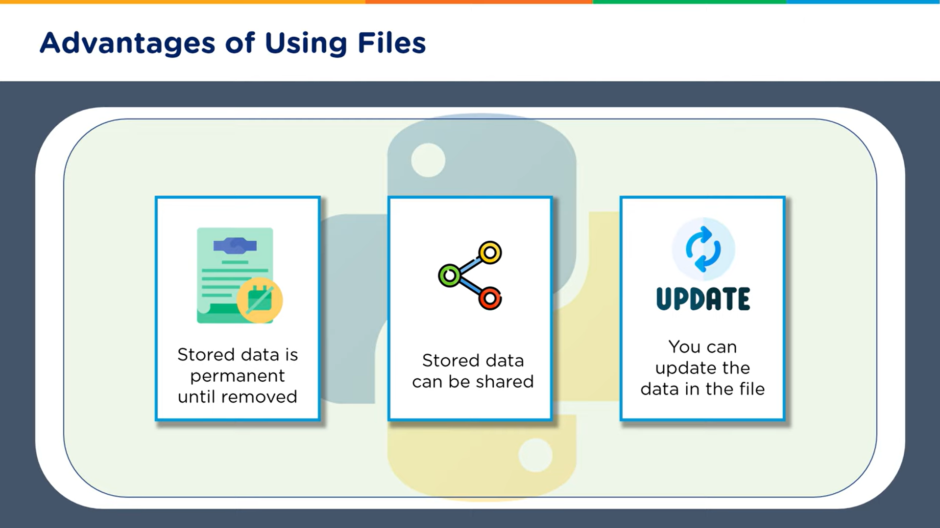

Slide 13
Uses of files
Text Editor: A text editor like Notepad or Sublime Text uses file handling to read and write text files. When you open a file, the editor reads the contents using Python's file handling capabilities. When you save the file, the editor writes the updated contents back to the file.
Web Development: Web applications use file handling to store and retrieve data, such as user uploads, session data, or configuration files.
Game Development: Games use file handling to store and retrieve game data, such as save files, level data, or assets. Python's Pygame library uses file handling to interact with the file system.
And Many More

